Slide 1

Professional English
School of General Education Disciplines
Topic: SDGs: Brainstorming creative solutions
Week 2. Practice 1-2
Term 1, 2026-2027

Slide 2
Objectives
By the end of this class, students will be able to:
generate and discuss creative solutions to SDG-related challenges through collaborative brainstorming and mind mapping;
identify key elements of an academic research article, including the research problem, aim, method, findings, and contribution;
interpret and evaluate research findings;
use academic and professional vocabulary to discuss SDG issues and research evidence.

Slide 3
Warm up
Work in pairs
Imagine the UN had asked you to design the SDGs.
You are allowed to add one goal that you believe is missing.
Give your goal a title in no more than five words.
Explain why your goal is necessary.

Slide 4
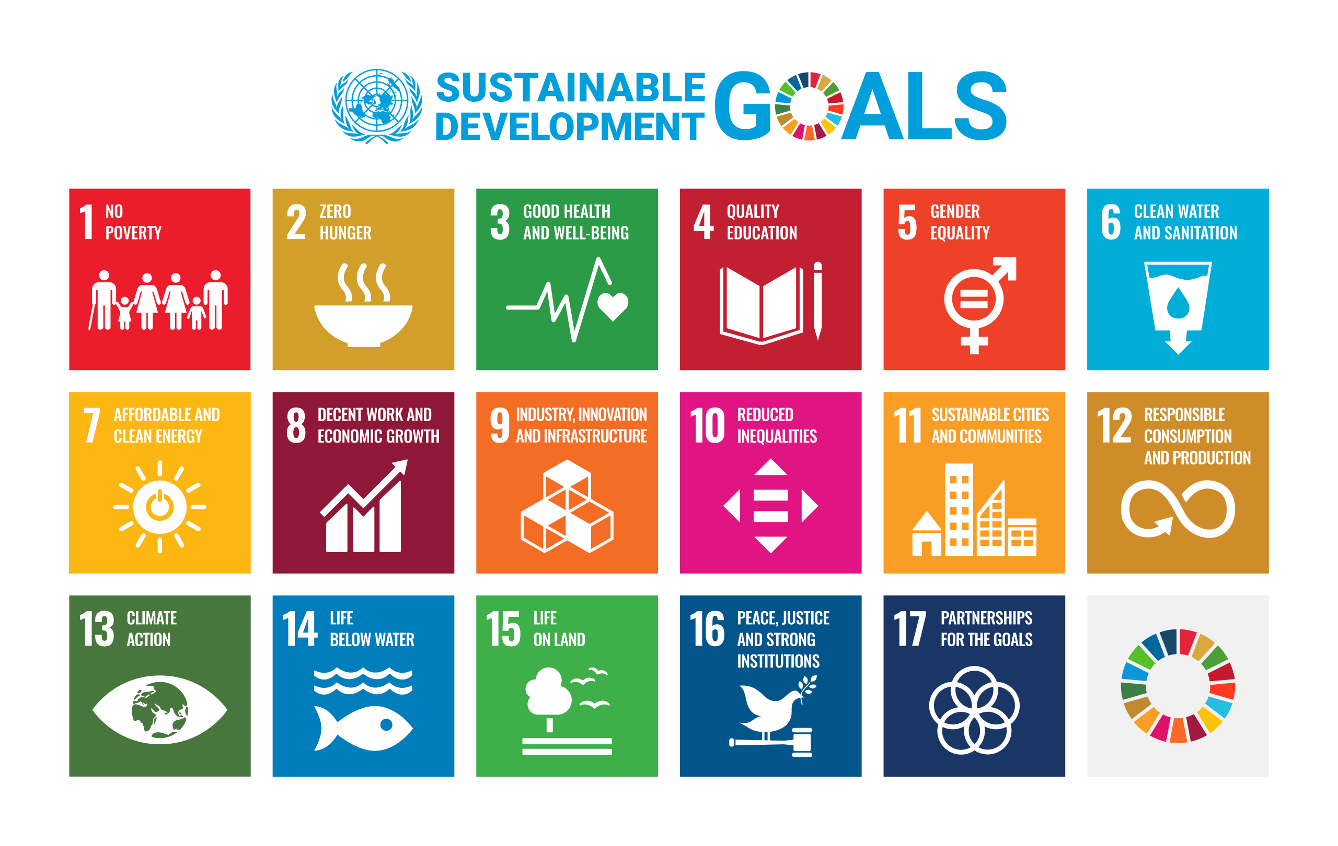
Brainstorming with mind maps (20 min)
1 Form a group of 3–4 students.
2 Choose 1 SDG (or your teacher will assign one).
3 Write the SDG in the center of your page.
4 Create a mind map:
Branch 1: Challenges (problems related to this SDG).
Branch 2: Solutions (possible actions or innovations).
Branch 3: Stakeholders (who is involved – universities, companies, communities).
Branch 4: Impact
5 Prepare to present your mind map to the class in 2–3 minutes.
6 While one group presents, other students should listen actively and ask at least two clarification or follow-up questions.

Slide 5
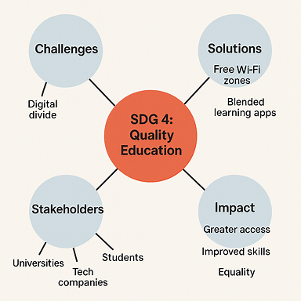
Mind map example on SDG 4

Slide 6
Prototype sketch (Assignment 1 – Week 3)
1. From your mind map, choose one solution that seems most realistic and innovative.
2. Research briefly (use reliable sources) to check if similar solutions exist and how they were implemented. Your idea should be informed by existing studies.
Sketch a prototype of your idea on paper. It does NOT need to be artistic.
3. You may design it as:
a poster
an infographic (problem → solution → impact)
a mobile app interface
a diagram
4. Prepare to present your prototype in 8-10 minutes: explain the problem, your solution, the expected impact, and mention its connection to any existing research
5. When presenting, make sure to use at least 5 phrases from the list on the next slide.

Slide 7
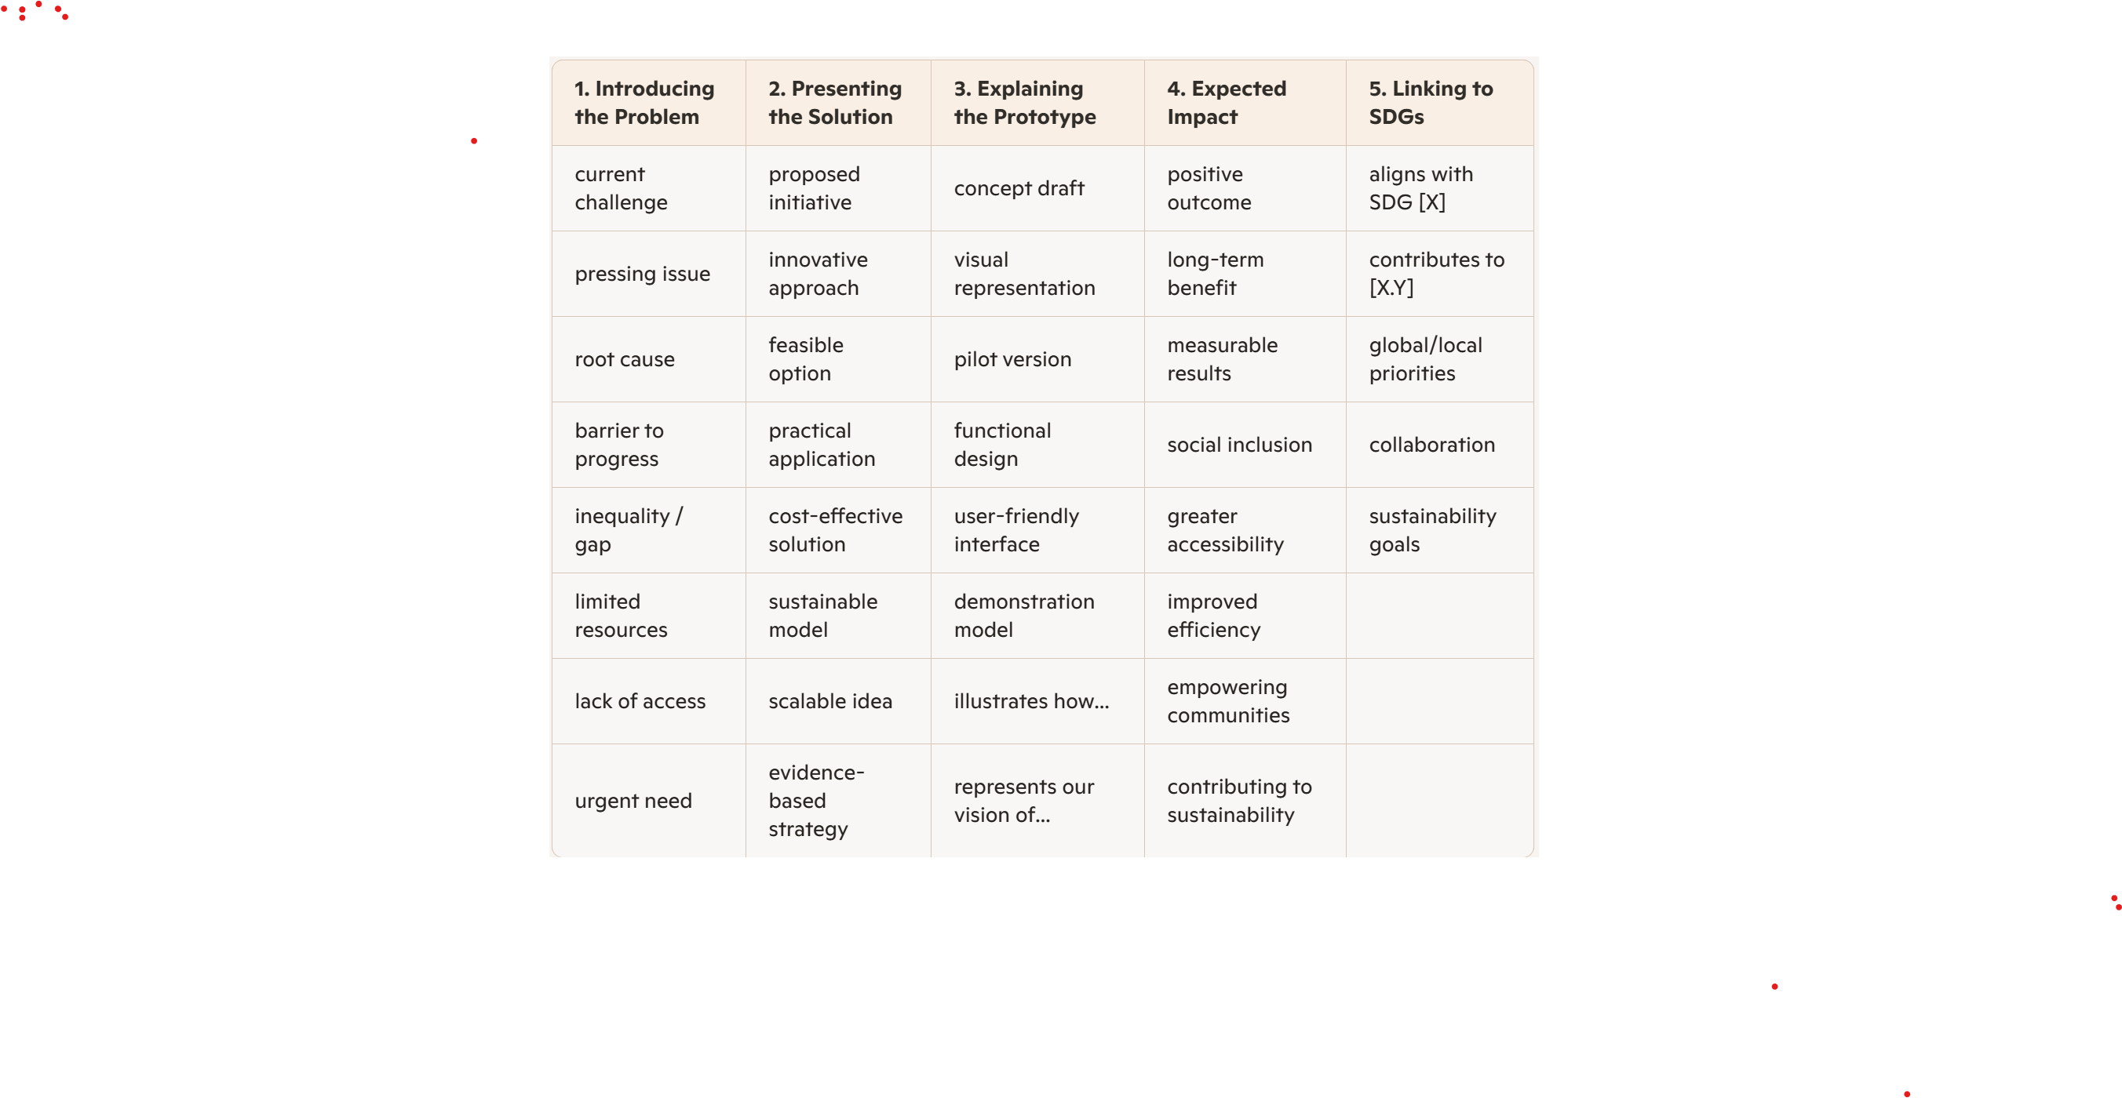
Professional Vocabulary for Prototype Presentations

Slide 8
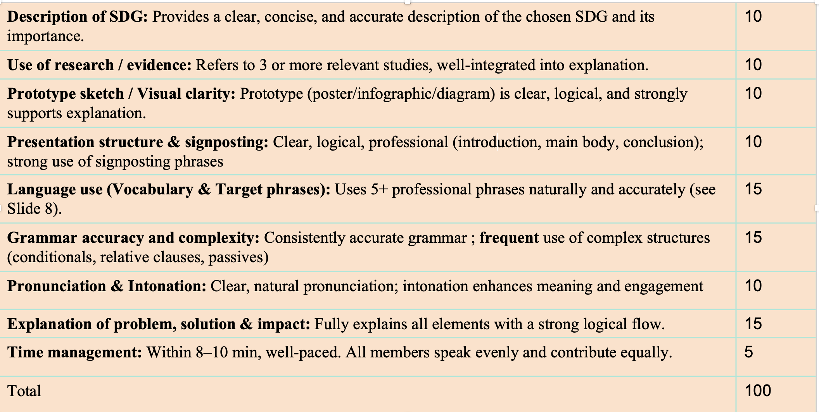
Assessment rubric

Slide 9
Abstract: Sorooshian (2024)
Read only the abstract. Complete the table.
Element | Evidence from the abstract
Research problem
Aim
Method
Main findings
Intended contribution

Slide 10
Introduction: Sorooshian (2024)
Read the introductory part of the article by Sorooshian (2024),(2024)
While reading, find a word in the text that matches each definition on the next slide.
A word meaning to completely remove or destroy something (para 1).
To state or argue something strongly as a fact or opinion (para 2)
A serious and determined attempt or effort to do something (para 3)
Measuring, assessing, or evaluating (para 3)
People or groups involved in or affected by a project (para 4)
The likelihood that something can be done successfully (para 5)
The quality of being directly related to or important for a particular subject or situation (para 5)
Depending on something else happening (para 6)
To begin or start something (para 6)
To correct something that is wrong or inaccurate (para 8)

Slide 11
Introduction: Sorooshian (2024)
Answer each question with a concise response.
1
What global problem does the author introduce?
2
What research gap does the author identify?
3
How does the author define “research-friendly”?
4
Why does the author believe this concept matters?
5
What is the study’s research objective?

Slide 12
Method: Sorooshian (2024)
Read the Method section. The stages below are in the wrong order. Number them 1–5 according to the order in which they are described in the article.
Ask two sustainability researchers to provide feedback on the ChatGPT responses.
___
Apply the EDAS method to evaluate and rank the SDGs by research-friendliness.
___
Collect research data for the SDGs from Scopus/SciVal.
___
Use ChatGPT to identify research obstacles associated with each SDG.
___
Evaluate the SDGs using seven research-friendliness criteria.
___

Slide 13
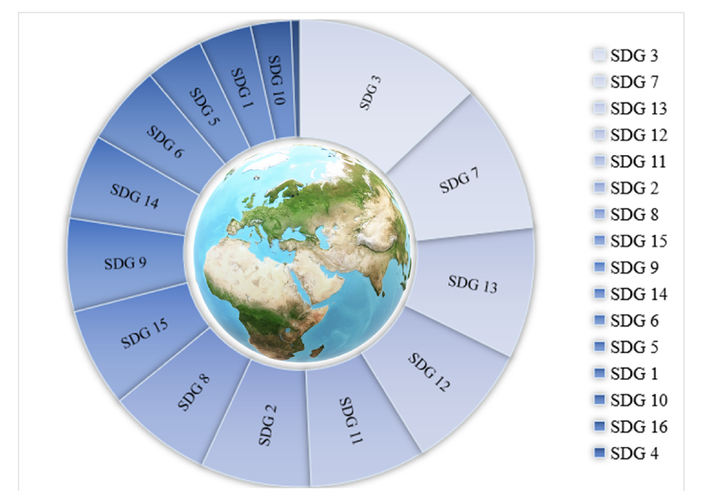
Results: Sorooshian (2024)
Study Figure 2 and the Results section. Support each answer with a detail from the article.
1
Which SDGs occupy the highest and lowest positions?
2
What does the ranking measure?
3
Why does SDG 17 not appear in the comparison?
4
Which result do you find most unexpected, and why?
5
What can this ranking not tell us about progress towards the SDGs?

Slide 14
Conclusion:Matching Headings: Sorooshian (2024)
The text has 5 paragraphs in the Conclusion section (do not count the last –the 6th).
Choose the best subheading (A–G) for each paragraph (1–5). There are two extra subheadings you do not need to use.
Possible Subheadings:
A. The necessity of balancing research efforts across all SDGs
B. Limitations of current measurement and future directions
C. Identifying the most and least research-friendly goals
D. The growing role of education and justice in sustainable development
E. Impartial evaluation as a contribution to global sustainability research
F. Calls for improved policies and removal of barriers
G. Data gaps, longitudinal studies, and the challenge of SDG 17

Slide 15
Home task
Learn the vocabulary bank.
Complete the Vocabulary worksheet for Week 2.

Slide 16
Thanks!
Do you have any questions?

